Slide 1
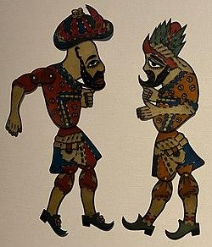
Karagöz and Hacivat
Shadow Play
KKJ

Slide 2
What is a shadow play?
A shadow play is performed on traditionally cut figures such as humans, animals and objects in front of a light source, and their shadows are stretched and reflected against a white screen. It is type of art to entertain people.

Slide 3
Who are Karagöz and Hacivat ?
Karagöz and Hacivat are the two best known actors of the traditional Turkish shadow puppetry. They are known with their fights, and they keep audience laugh. Karagöz always misunderstands Hacivat and it makes the puppetry funnier.

Slide 4
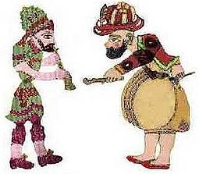
General Characteristics of Hacivat and Karagöz
Karagöz and Hacivat appear as two opposing characters. Their behavior, thoughts and speeches are the most significant indicators of this contrast. When we look at the character of Hacivat, we see that he is an intellectual person. On the other hand, Karagöz depicts a character who is impolite in his manners and an illiterate person.

Slide 5
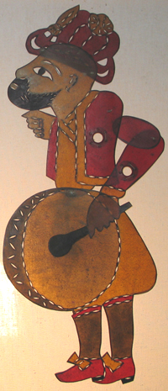
Who is Hacivat?
According to a rumor, Hacivat’s real name was “Hacı İvaz Ağa”.
Hacivat was an educated and cultured man.He also knew Arabic and Persian.
He was ironmaster in Bursa.
He worked in a mosque building in Bursa in the time of Osman Gazi.
He is clever and wise and one of the main
puppet characters.

Slide 6
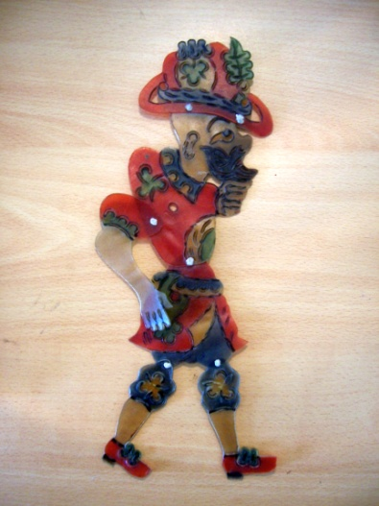
Who is Karagöz?
According to a rumor, Karagöz was born in Trakya’s Samakol Village.
Karagöz was bald, brave, uneducated man.
He was a bricklayer in Bursa.
He worked in a mosque building in Bursa in the time of Osman Gazi too.
He is so funny.
He is one of the main puppets, too.

Slide 7
The Original Story
According to a legend, they were real people. They worked as construction workers in a mosque in Bursa. Although their satiric jokes entertained other workers it also delayed the building of the mosque by their constant joking together. This made the sultan very angry and he believed that it was a rebel to him. As a result of this, they were executed. The construction of the mosque was completed without them, but their comrades did not forget them and kept their jokes alive, telling them over and over.

Slide 8
The Original Story
After this decision, it is the Sheikh Kushteri who gives comfort to the sultan who regrets about this decision. It is rumored that they first took part in the shadow play with Sheikh Kushteri removing the turban from his head and turning it into a curtain, putting a light behind it, and portraying Karagöz and Hacivat with his shoes.In time, the adventures of Karagoz and Hacivat gained a new dimension and the traditional Turkish shadow puppet theater was born. Their monumental tomb stands in Bursa city today.

Slide 9
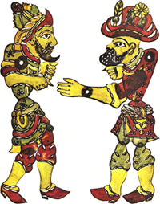
What are the themes of the Karagöz and Hacivat Shadow Play?
Karagöz and Hacivat Shadow Plays deal with the everyday lives that are not too complicated. Daily affairs are arranged in a simple and entertaining way and presented to the audience.
The stories can include poets or wrestlers too.

Slide 10
When do people watch it?
Turkish people generally watch this play et the end of Ramadan. Ramadan is a holy month for Muslim. In this month, people fast to empathize with the poor people. They don’t eat or drink anything from the sunrise to sunset. And after sunset they eat, then they generally go to mosque, in the end, they watch Karagöz and Hacivat shadow play to have fun.

Slide 11
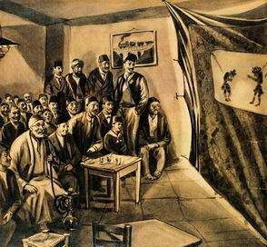
Karagöz and Hacivat shadow play in the Ottoman

Slide 12
About the puppeteer
The puppeteer holds the puppet close against the screen with rods. Karagöz and Hacivat shadow play is played depending on the talent of an artist. Moving the design on curtain, voicing them, dialects or imitations are all made by the artist. The subjects of Karagöz plays are funny elements with double meanings, exaggerations, verbal plays, and imitating accents. There is always satire and irony in it.

Slide 13
End
Thank you for listening to me.I hope you learned :
What shadow play is
What Karagöz and Hacivat shadow play is
What type of characters they are
What their dialogues are about
What their real story is

Slide 14
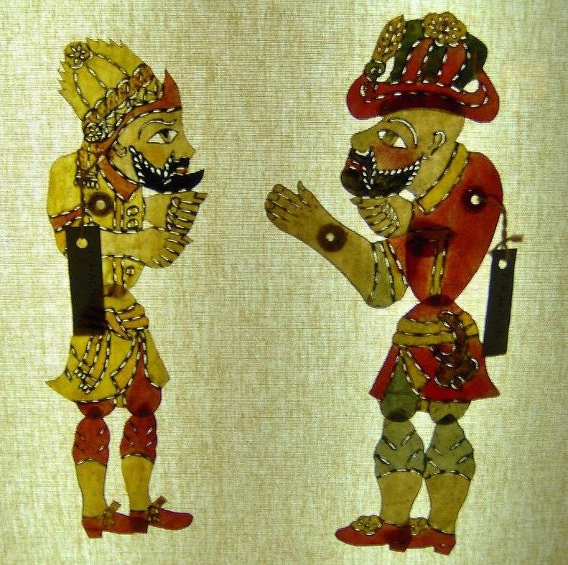
Lets watch a play!
Karagöz Hacivat play:

